Slide 1
Info-6079 Security Application Week 4
Modules

Slide 2
Lecture will cover
What is a module?
What is a package?
Why use Modules or package?
Ways of getting modules and packages
Finding built modules and packages
How to use Modules and package
Write your own Modules and package

Slide 3
What are Modules?

Slide 4
Module
Module consists of Python code that has a specific goal or functionality. Like calculate a network range.
Could include, but not limited to:
Functions, Variables, Classes, Runnable code
Modules help avoid collisions between global variable names. Meaning that a variable in a module is in the module and not in other modules.
Any Python file can be a module.
You can use modules that are already made and provided with python
You can create your own code and save it as a python file, use the extension .py
Notes:
The code written in your labs could be used in future code. If you use the keyword import and the file name without the extension .py.

Slide 5
What is a package?

Slide 6
Package:
A package is a collection of modules in a directory.
Could contain other packages in it as well
Packages provide away to create a hierarchy structure within a names of modules.
Using dot notation. .
In the package, there has to be a file named __init__.py
Could be empty or have code that controls how the module package exports modules.
Will see later in the lecture

Slide 7
Why use Modules or packages.
Allow coders to logically arrange their code into small building blocks.
Modules and package could be reused in several applications without rewriting the same code over and over again.
Modules already work don’t need to recreate the logic and code.
If the code needs to be fixed or update. The change could be done in a single place and every code using the module will be updated.

Slide 8
Two ways of getting modules and packages
Modules that are build by python community
Some come with Python installation and/or with development environment
Others you may need to download and installed
Custom made
Write by your self
Written by a team member
Getting someone to write for you

Slide 9
Looking for build Modules and Packages?

Slide 10
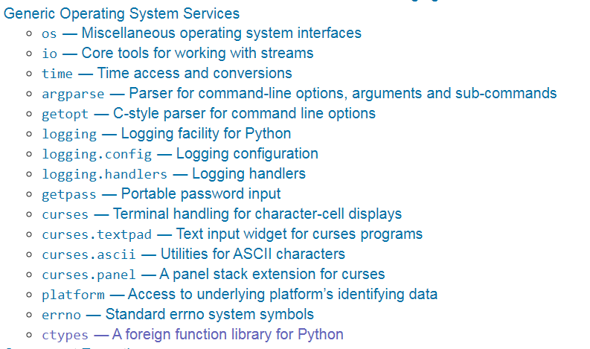
Some Modules provided by Python community
Source: https://docs.python.org/3/library/
Notes:
We will use some of these and maybe others throughout the course

Slide 11
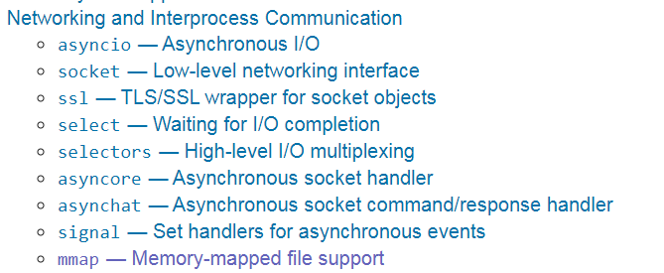
Some Modules provided by Python community
Source: https://docs.python.org/3/library/

Slide 12
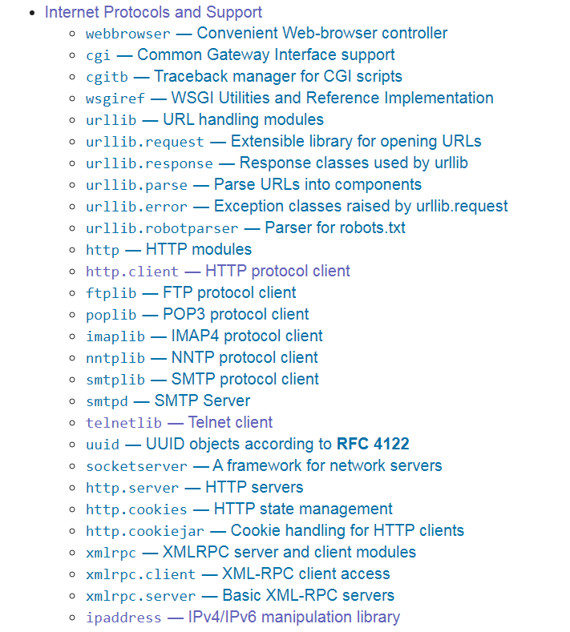
Some Modules provided by Python community
Source: https://docs.python.org/3/library/
Notes:
Good one to work with is ipaddress. Can help with IPv4 and IPv6 addresses.

Slide 13
MODULES used
Sockets
in lab re: sockets
sqlite3
Used to connect to database
random
Used random.randint to get a random integer
os
check if a file exists

Slide 14
Resources for Module:
https://docs.python.org/3/library/
Has a list of modules and descriptions of standard libraries that come with Python
https://pypi.org/ (Python Package Index)
Has a software repository for Python
Can help find and software that is shared by Python community

Slide 15
Famous Non standard modules and packages:
Other famous ones include (need to be downloaded and installed)
NumPy - is the fundamental package for scientific computing with Python.
Can be downloaded at NumPy.org
Pandas – open source for data analysis
Can be downloaded form: pandas.pydata.org

Slide 16
Installing Modules/Packets
Some modules and packets may need to be downloaded and installed on your device
Python comes with inbuilt package management system , pip.
Can install, update, or delete all official packages

Slide 17
How to use Modules and Packages

Slide 18
Using modules and packets:
Need to use the keyword import and then give the name of the module, without the .py extension.
Done at the beginning of the file.
Three ways usually seen:
import ipaddress
import ipaddress as ip
from ipaddress import IPv4Network

Slide 19
Example 1:
# import module
import ipaddress
#functions
def network_info(strIP_address, subnet):
ip_sub = strIP_address + "/" + subnet
sub = ipaddress.IPv4Network(ip_sub)
return sub
def get_hosts(subnet):
hostz = list(ipaddress.IPv4Network(subnet).hosts())
return hostz

Slide 20
Example 1 con’t:
sub = network_info('10.10.0.0','24')
print sub
print("Network ID : " ,sub.network_address)
print("Broadcast : " , sub.broadcast_address)
print("Netmask : " , sub.netmask)
host = get_hosts(sub)
print("Hosts : " , end=" ")
for ip in host:
if ip == host[-1]:
print ip
else:
print(ip, end=" ")

Slide 21
Example 2:
Could provide a name that is easier for you to write
# import module
import ipaddress as ip
#functions
def network_info(ip_address, subnet):
ip_sub = ip_address + "/" + subnet
#sub = ipaddress.IPv4Network(ip_sub)
sub = ip.IPv4Network(ip_sub)
return sub
def get_hosts(subnet):
#hosts = list(ipaddress.IPv4Network(subnet).hosts())
hosts = list(ip.IPv4Network(subnet).hosts())
return hosts(ipaddress.IPv4Network(subnet).hosts())
hosts = list(ip.IPv4Network(subnet).hosts())
return hosts

Slide 22
Example 3:
Could call only functions you want from module
If you want all functions, put *
# import module
from ipaddress import IPv4Network
#functions
def network_info(ip_address, subnet):
ip_sub = ip_address + "/" + subnet
#sub = ipaddress.IPv4Network(ip_sub)
sub = IPv4Network(ip_sub)
return sub
def get_hosts(subnet):
#hosts = list(ipaddress.IPv4Network(subnet).hosts())
hosts = list(IPv4Network(subnet).hosts())
return hosts

Slide 23
All 3 will output:
10.10.0.0/24
Network ID : 10.10.0.0
Broadcast : 10.10.0.255
Netmask : 255.255.255.0
Hosts : 10.10.0.1, 10.10.0.2, 10.10.0.3, 10.10.0.4, . . .,

Slide 24
Example 3 options
If you would like to have multiple functions from module put comma between them
from ipaddress import IPv4Network, ip_network
If you want all of the functions just put a *
from ipaddress import *

Slide 25
Write your own modules and Packages

Slide 26
Example for Module and package
We would like to have a reusable code for our login applications.
What do you think that should be in the code?
How should the code be divided into?
Modules User and Password
Package login

Slide 27
Download zipped file from FOL
Zipped file has the following
using_login_package.py
Folder Login
__init__.py
extra_code.py
password.py
User.py
Leave the pythons files in their folder

Slide 28
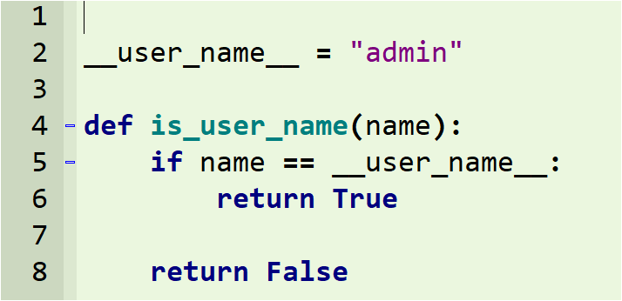
User.py

Slide 29
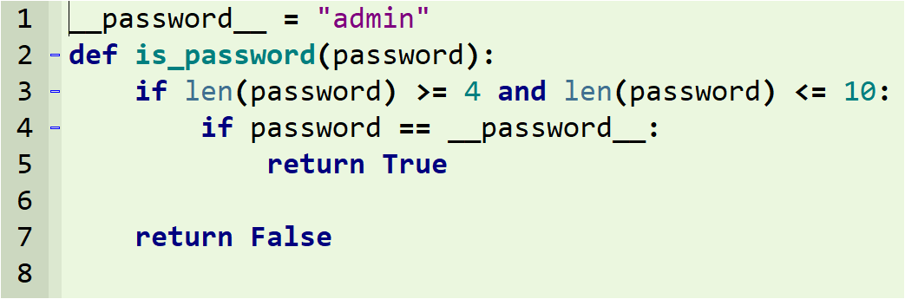
password.py

Slide 30
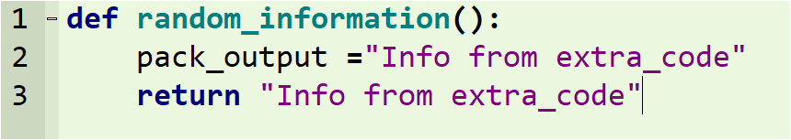
extra_code.py

Slide 31
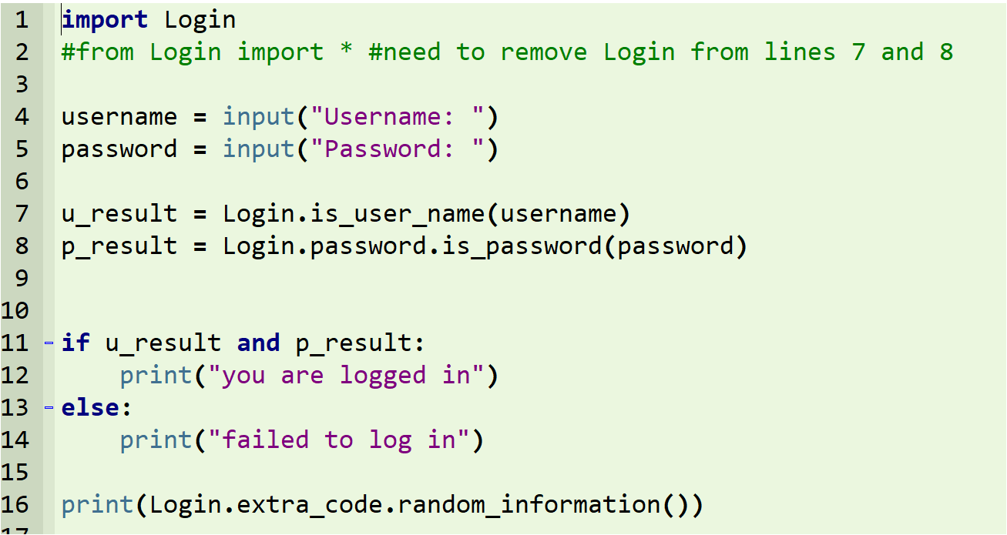
using_login_package.py

Slide 32
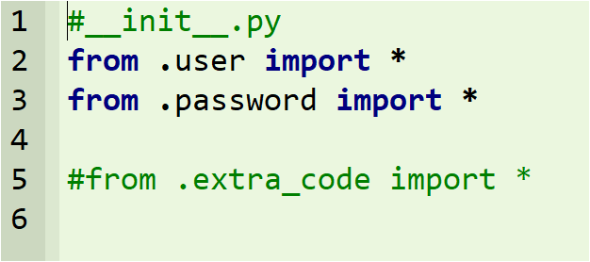
__init__.py

Slide 33
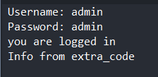
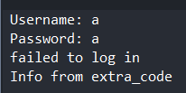
Output
Logged in
Not Logged in

Slide 34
Change code:
Play with one of the module and see that it will affect using_login_package
Play with __init__.py by committing line 5
from .extra_code import *
Should get an error: module 'Login' has no attribute 'extra_code'

